Slide 1
Scan Conversion
CSC 4122: Computer Graphics

Slide 2

Pixel

Slide 3
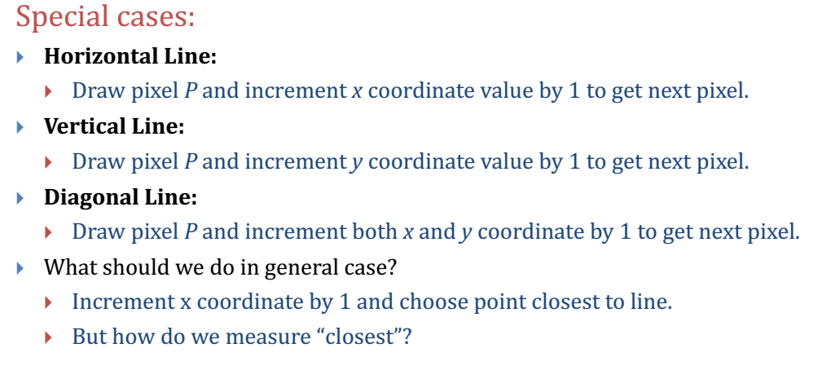
Finding the next pixel

Slide 4
Incremental Algorithm
Incremental Algorithm is a line drawing algorithm
Start from initial pixel to reach final pixel to draw a line
Three Requirements:
Integer Pixel Grid
Slope
Disjoint Pixel

Slide 5
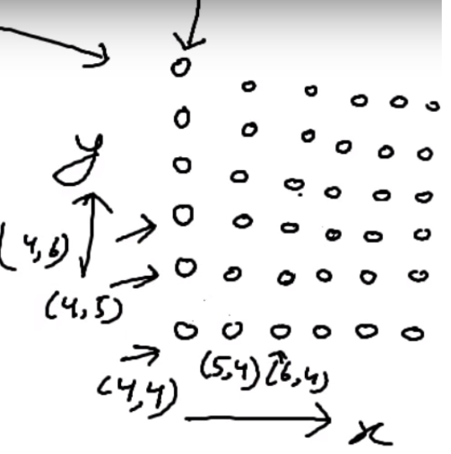
Integer Pixel Grid

Slide 6
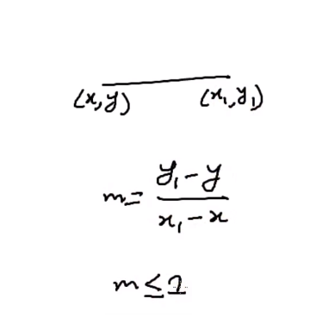
Slope

Slide 7
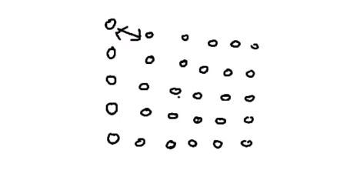
Disjoint Pixel

Slide 8
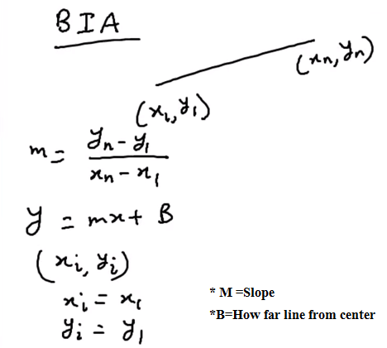
Equation of Line

Slide 9
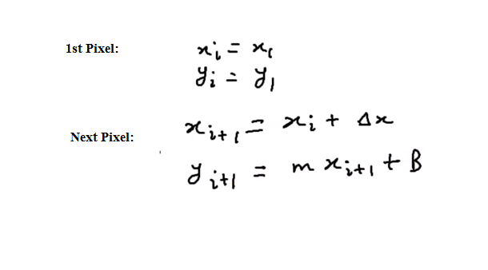
Finding Pixel

Slide 10
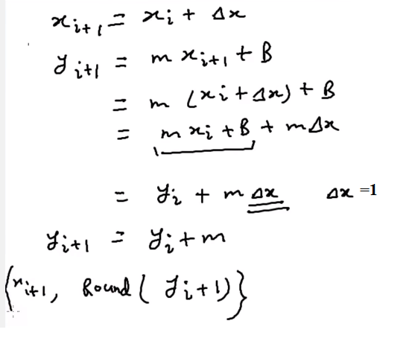
Setup coordinate for next pixel

Slide 11
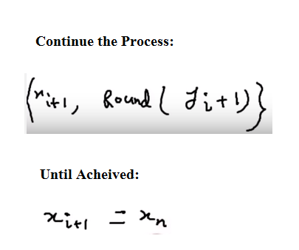
Setup coordinate for next pixel

Slide 12
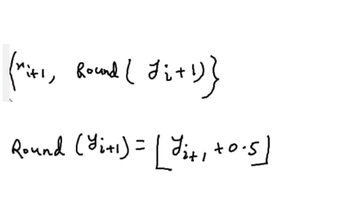
Setup Coordinate for Next Pixel

Slide 13
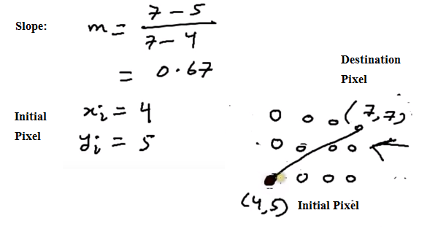
Calculate 1st Pixel

Slide 14
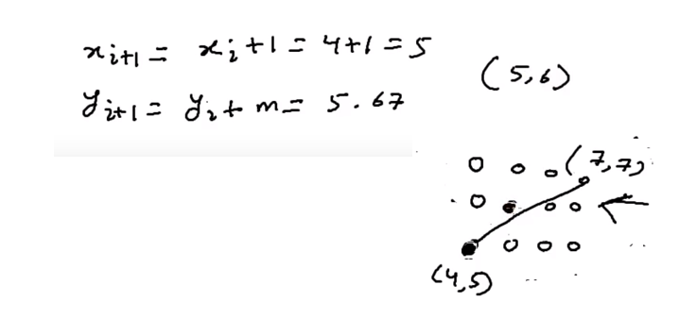
Second Pixel

Slide 15
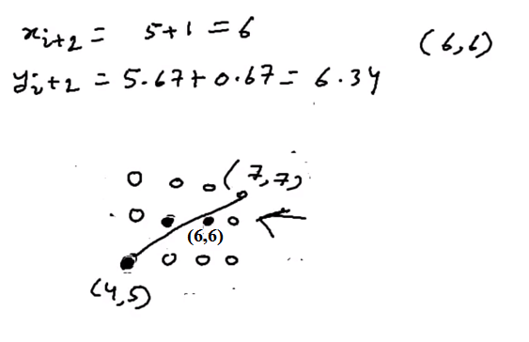
3rd Pixel

Slide 16
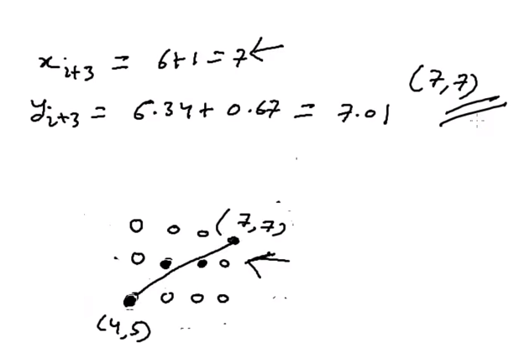
Final Pixel

Slide 17
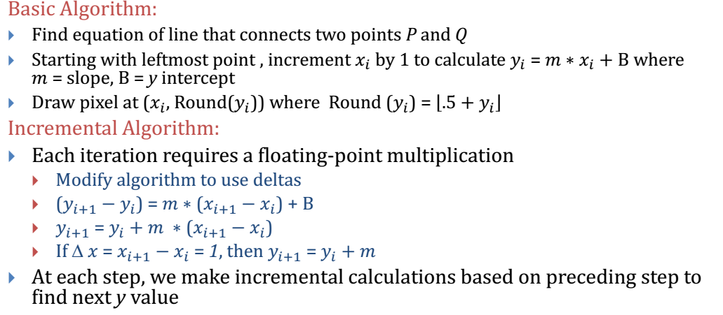
Strategy 1 – Incremental Algorithm

